Slide 1
Introduction to Regular Expressions

Slide 2
What kinds of problems can we solve using regex?

Slide 3
Workshop structure
Literal string matching
The basic elements of regex
Exercise 1
Grouping
Non-capturing groups
Exercise 2
Additional resources
Notes:
Flavours of regex: R, by default uses POSIX, can switch to PCRE (PHP) within string function you’re using

Slide 4
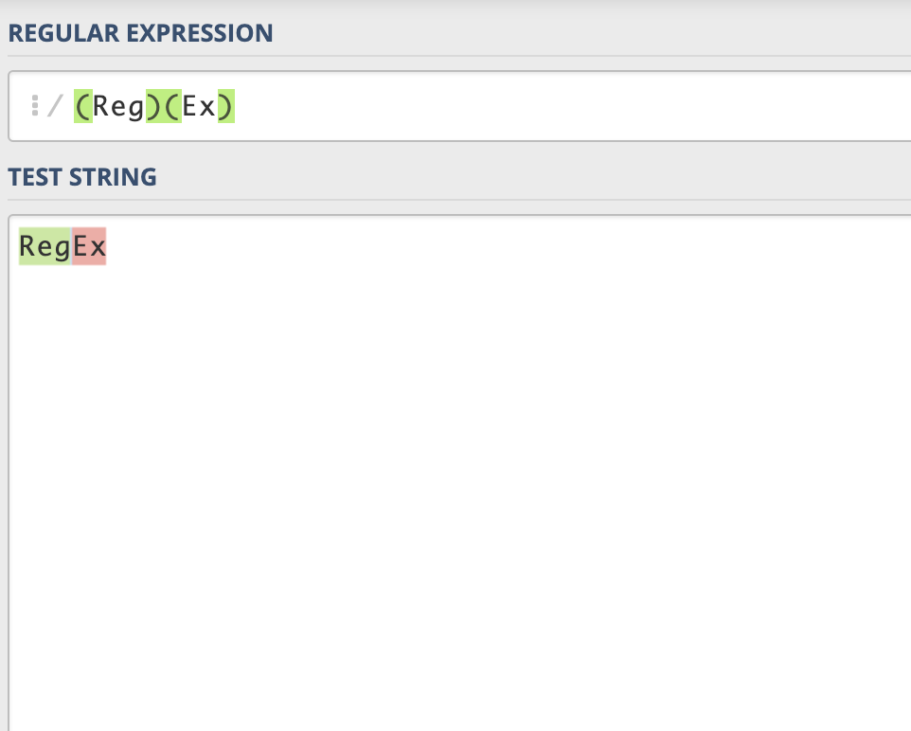
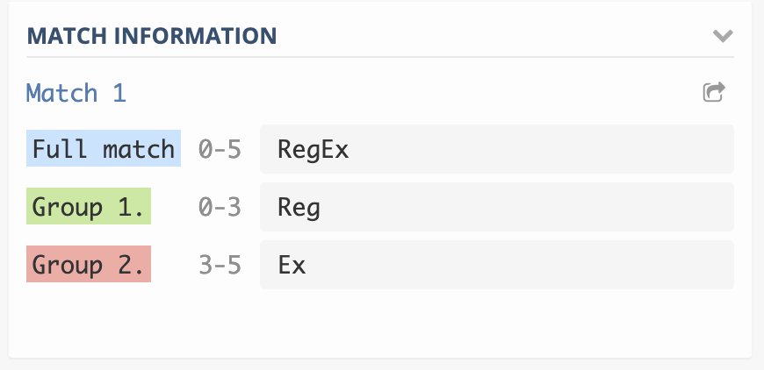
Regex101.com
No need to install any software or have a background in a specific programming language
Useful for testing your regular expressions before using them in your program
Great for learning: explanation section provides details on why a given regular expression works; quick reference section makes common tokens easily accessible

Slide 5
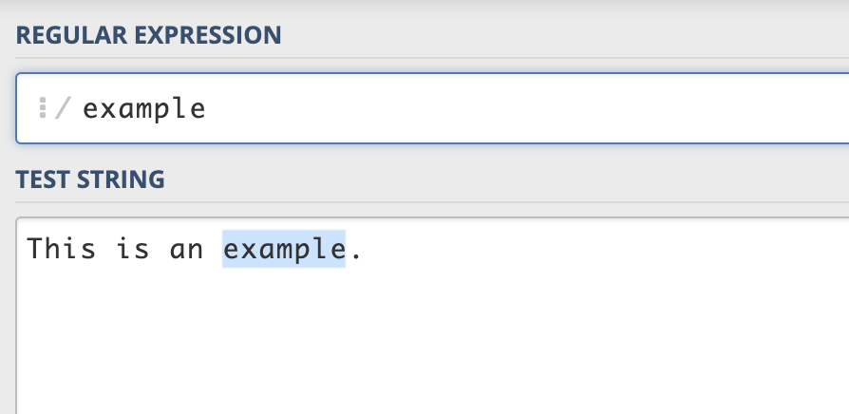
The string match you are looking for

Slide 6
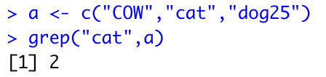
Using RegEx within a program
Simple example: the grep function in R
“grep(pattern, x) returns a vector of the indices of the elements of x that yielded a match”
pattern is the string you are looking for, that’s where the regex would go
How would this work with an actual dataset?

Slide 7
Character classes
Types of characters that can be matched. These match one character (unless specified otherwise - we’ll cover that later).
[aeiou]: match any one lowercase vowel [AEIOU]: match any one uppercase vowel [a-z]: match any lowercase letter [A-Z]: match any uppercase letter [0123456789] or [0-9]: match any one digit | [a-zA-Z0-9]: match a character from any of the aforementioned classes [^aeiou]: match anything other than a lowercase vowel [^0-9]: match anything other than a digit

Slide 8
Shorthand character classes
\d: digit character ([0-9]) \D: non-digit character \s: space character ([\r\n\t\f\v ]) \S: non-space character | \w: word character ([0-9A-Za-z_]) \W: non-word character \b: word boundary \B: non-(word boundary)
Notes:
Show an example of each on an article
Some extra definitions:
\s - space character is [\r\n\t\f\v ]
\r: carriage return, \n: new line, \t: tab, \f: form feed (printer starts a new page), \v: vertical space, and a space!
\w - word character is [0-9A-Za-z_]
\b - word boundary is position before string if it starts with word character, after string if it begins with word character or middle of string if there is a non-word character in the string

Slide 9
More useful tokens
\ | used to escape characters
| | the pipe symbol/vertical bar is for alternation
. | the dot matches any character (except line break characters)
^ | matches at beginning of the string (or line, if /m, as in our instance of Regex101)
$ | matches at the end of the string (or line, if /m, as in our instance of Regex101)

Slide 10
Quantifiers
? | the preceding item is optional and will be matched at most once
* | the preceding item will be matched zero or more times
+ | the preceding item will be matched one or more times
{n} | the preceding item will be matched exactly n times
{n,} | the preceding item will be matched n or more times
{n,m} | the preceding item will be matched at least n times and at most m times

Slide 11
Exercise 1 – Article
Identify all the adverbs ending in “ly”
You should get 6 matches

Slide 12
Grouping
A group is delimited by parentheses: (). The result of the extraction includes the whole match, followed by each capturing group. How you access these will depend on the software/programming language you are using.
Ex.: the regular expression (Reg)(Ex)(101) matches the whole match - RegEx and also yields the first capturing group - Reg, the second capturing group - Ex, and the third capturing group - 101.
Why use grouping?
Allows to use a quantifier on the entire group
Easier to extract the desired data:
When capturing, the matched groups are captured separately
Can also match part of the expression without capturing it

Slide 13
Non-capturing groups
Grouping allows you to match parts of a regular expression without capturing them (ie. the non-capturing group is matched but discarded and does not appear in the match results)
A non-capturing groups begins with ?:
Ex.: the regular expression (Reg)(?:Ex)(101) matches the string RegEx101, and also yields the first capturing group - Reg, and the second capturing group - 101. Ex is not a capturing group and is excluded from the result.

Slide 14
Exercise 2 - Phone Numbers
From each phone number and with a single “piece” of regex, match the following four groups:
Country code (try making this a non-capturing group)
Area code
First three digits
Last four digits

Slide 15
Additional resources
www.Regular-Expressions.info: exhaustive resource for tutorials that cover many RegEx topics, including language-specific functions
Handling and Processing Strings in R, by Gaston Sanchez
Covers a variety of packages and functions for handling strings in R, includes two sections covering the basics of regular expressions
Mastering Regular Expressions, by Jeffrey Friedl

Slide 16
How does the regex engine work?
In Regex101, we have a global setting on, which returns the all matches. What if we didn’t?
The regex engine is eager to find a match, it will return the leftmost match (the first match it finds)
To understand the logic, focus on a literal string match
Tries to find first token in first character of string
Success? Advance to second token and second character of string
Fail? Try the first token against the second character
Success? Advance to second token and second character of string
Fail? Try the first token against the third character
And so on and so forth until there is a match
The engine will return the first match (leftmost) it encounters, even though there might be a “better match” further in the string
Notes:
Engine = set of rules directing how regex matches tokens to characters

Slide 17
Quantifiers: greedy vs lazy
The + is a greedy quantifier: it will match as many instances of the preceding token as it can
A concrete example:
String: “This is a sentence. Here is another sentence.”
We would like to match each sentence separately.
We try this regex: \w.+\. Result: “This is a sentence. Here is another sentence.” It matches both sentences because the + is greedy and matches as many instance of the dot (which matches any character) as possible.
Second attempt, making the + lazy: \w.+?\. Result: it matches each sentence separately, matching the dot to the fewest possible characters.
Match 1: “This is a sentence.”
Match 2: “Here is another sentence.”

